Slide 1
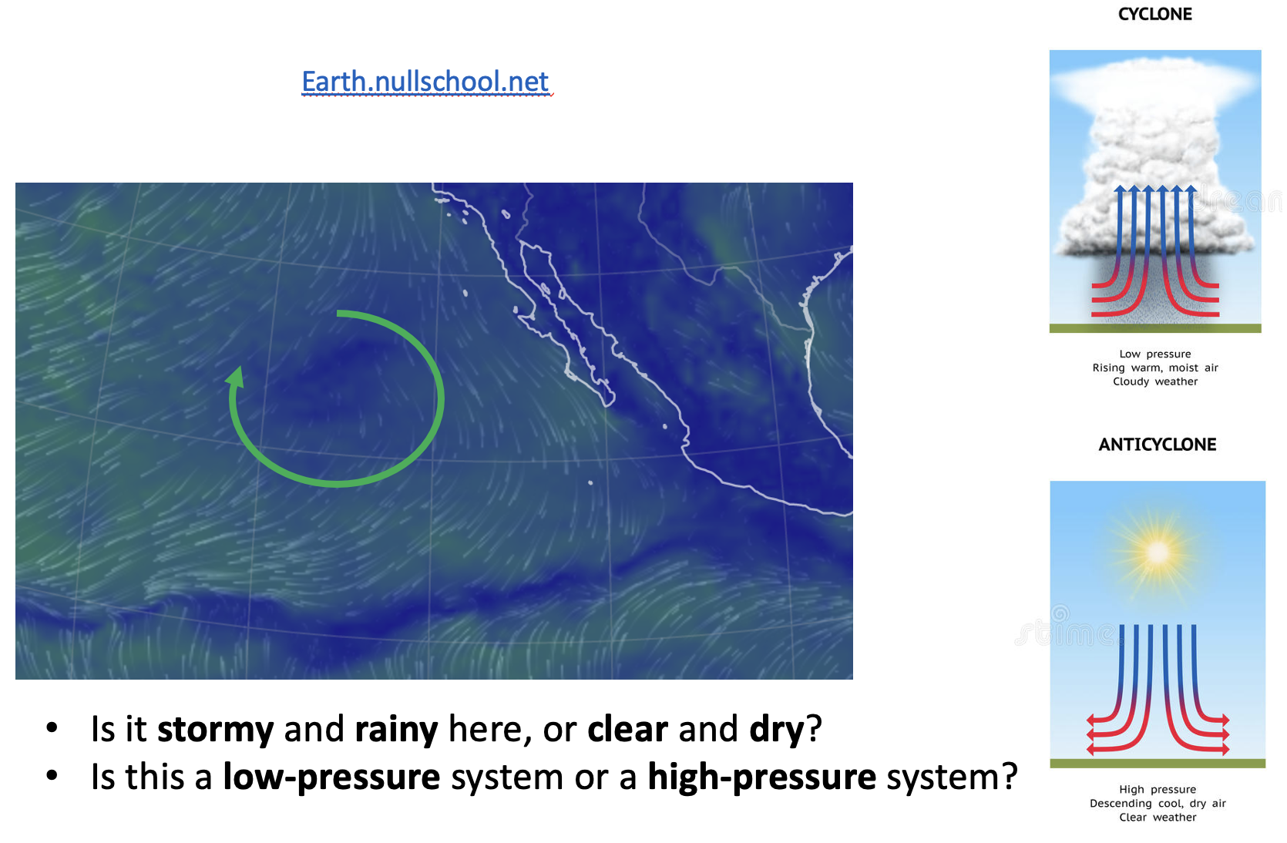
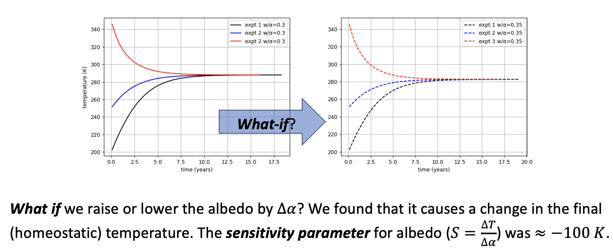
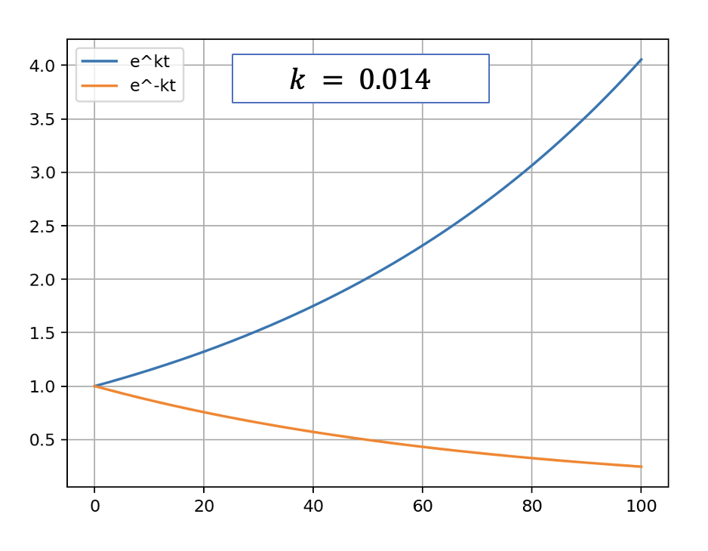
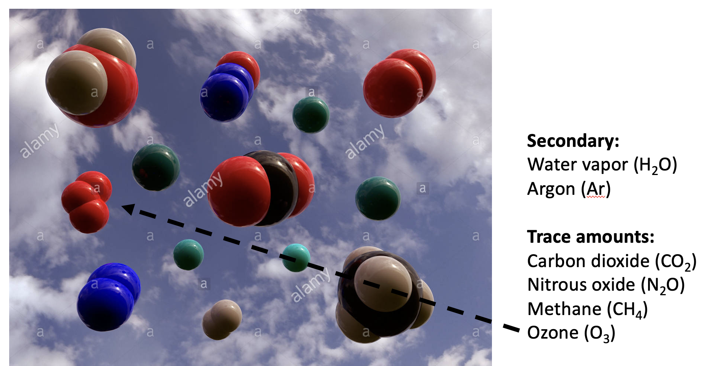
Last time, we talked about the format of the interviews, with some specific examples …
See Week 6.1a (Monday) Interview preparation - format and tips
Today, it’ll be more of a review of concepts with a smattering of sample questions.

Slide 2
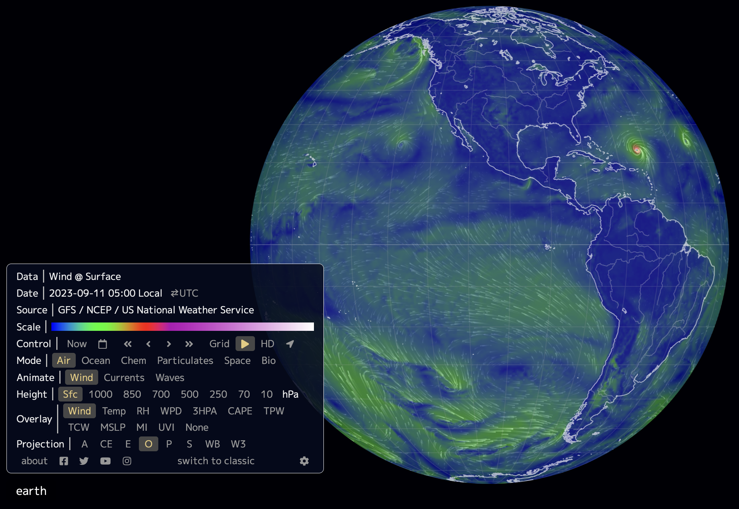
Week 1: Earth.nullschool.net gave us a global perspective, if on a short time scale
Some regions of the planet have especially low CO₂ concentrations in the air => must be net CO₂ sinks. Other parts are net CO₂ sources.
The “jet stream” is evident if you go high enough in the atmosphere.
Synoptic systems (low-pressure, high-pressure) can be identified by their pressure and wind direction.
Some synoptic systems are semi-permanent.
Much of the air pollution in urban centers (and the attendant health risks) is due to emissions from burning fossil fuels.

Slide 3
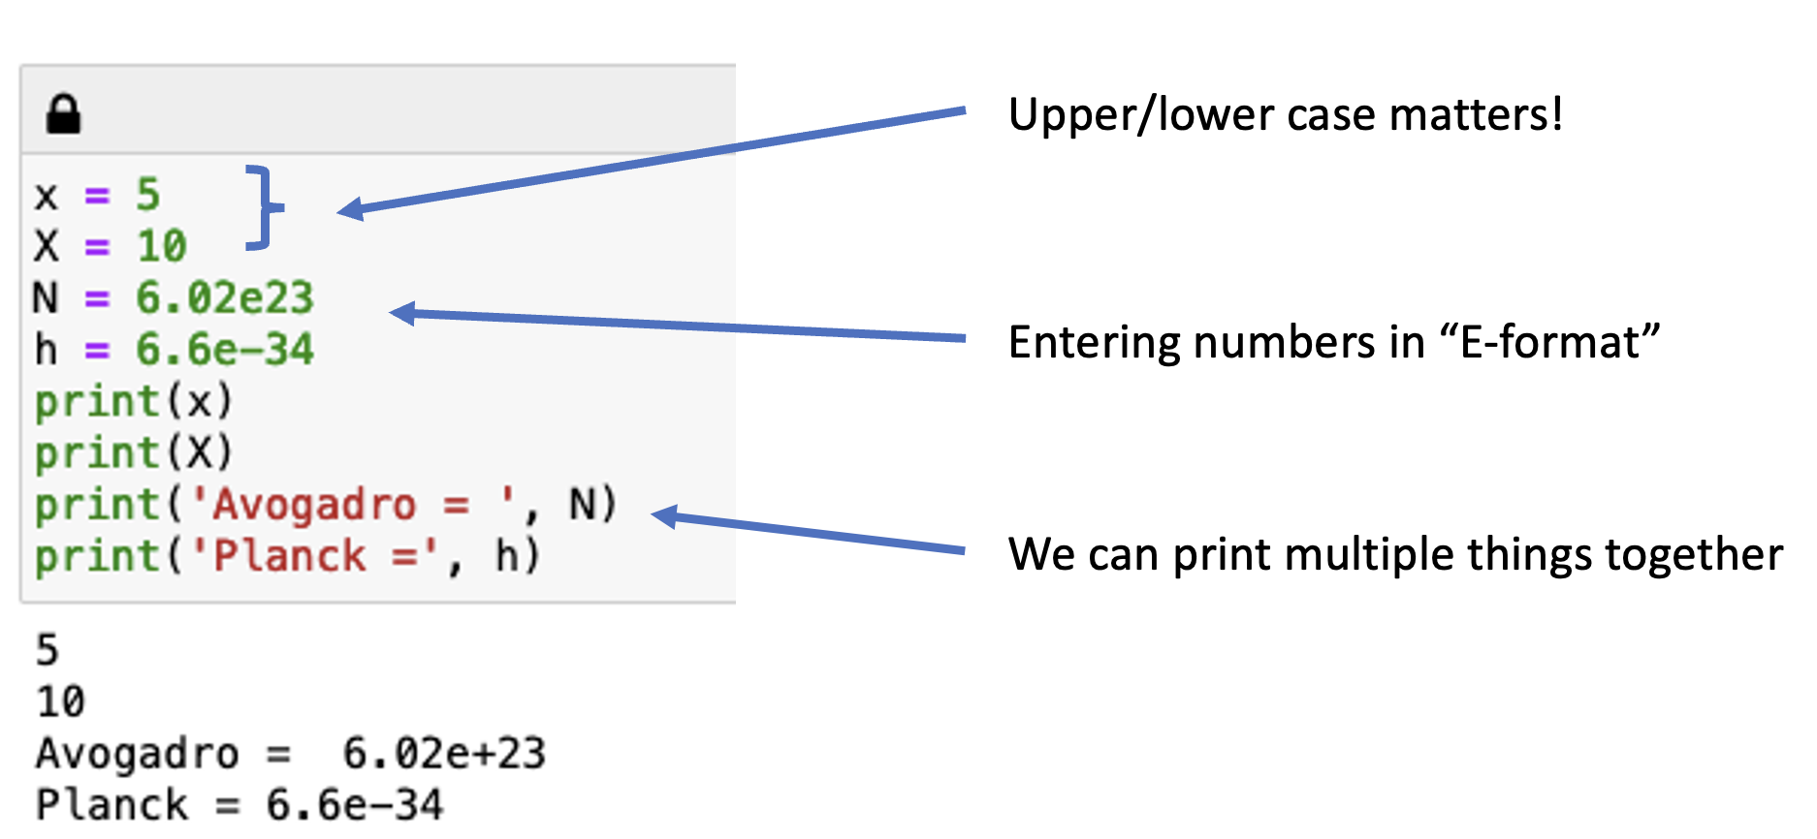
Week 1: We also got an introduction to key concepts of Python
Plus …
Order of operations
How to construct arrays
How to make graphs with labeled x- and y-axes

Slide 4
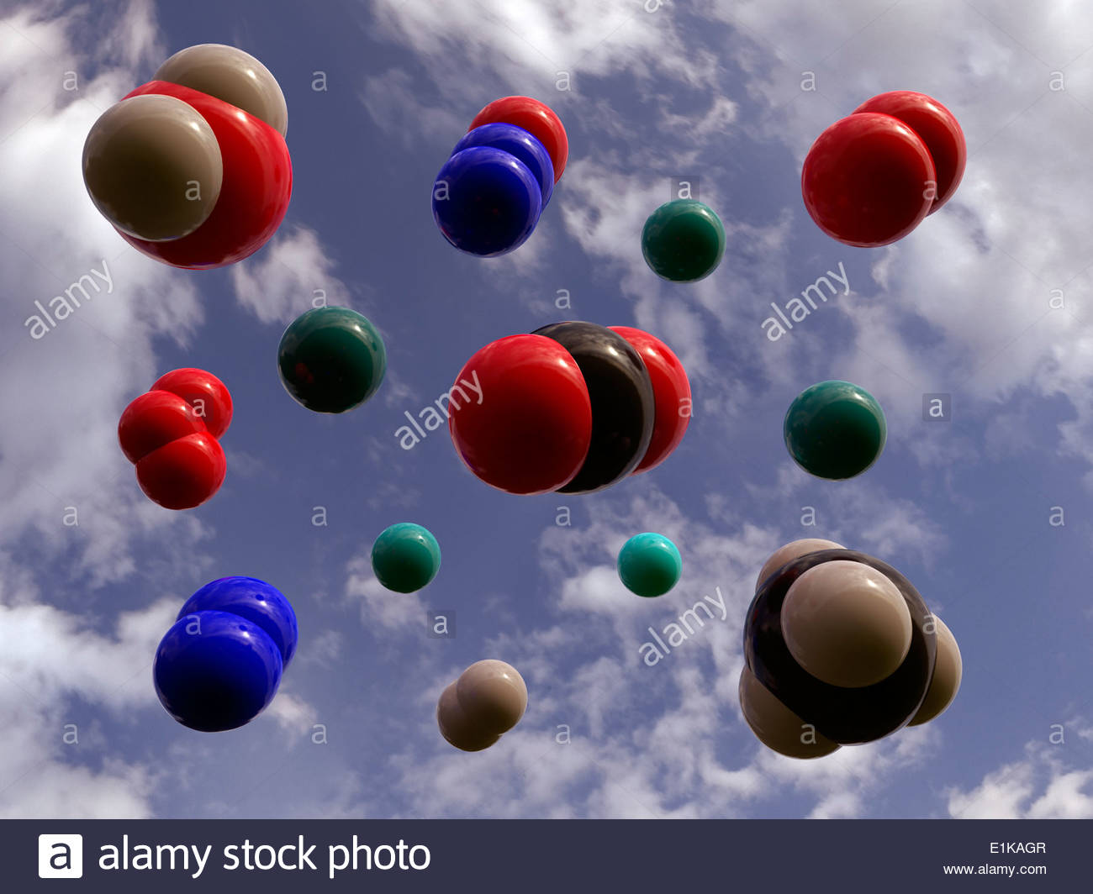
Week 1: We talked about the composition of the atmosphere
What Earth’s atmosphere is made up of, and what the concentration units (ppt, ppm, ppb, etc.) stand for.
Example: Of the following, which gas has the highest concentration in the atmosphere? Which has the lowest?
Ar: 1%
CO₂: 419 ppm
CH₄: 1922 ppb
H₂O: 2 ppt (but variable)
N₂: 78%
N₂O: 336 ppb
O₂: 21%

Slide 5
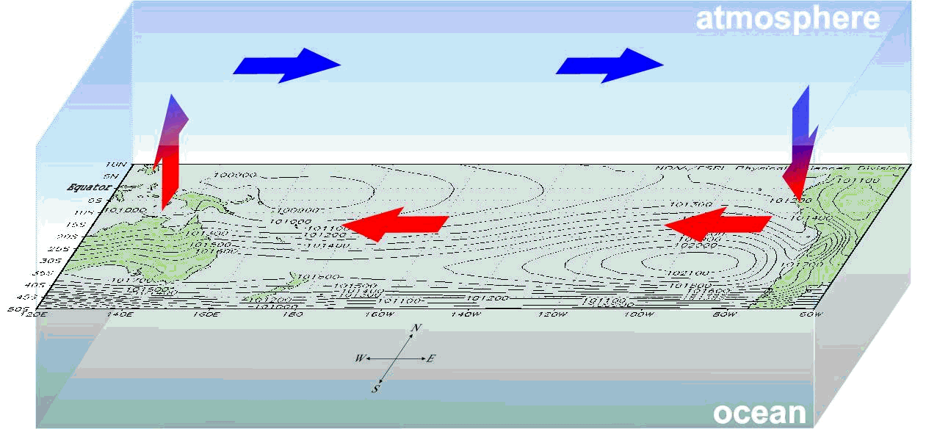
Week 2: We saw that shifts in certain semipermanent synoptic systems lead to ENSO variability
Nauru Low
Nauru Low
Chilean High
Chilean High
Upwelling water

Slide 6
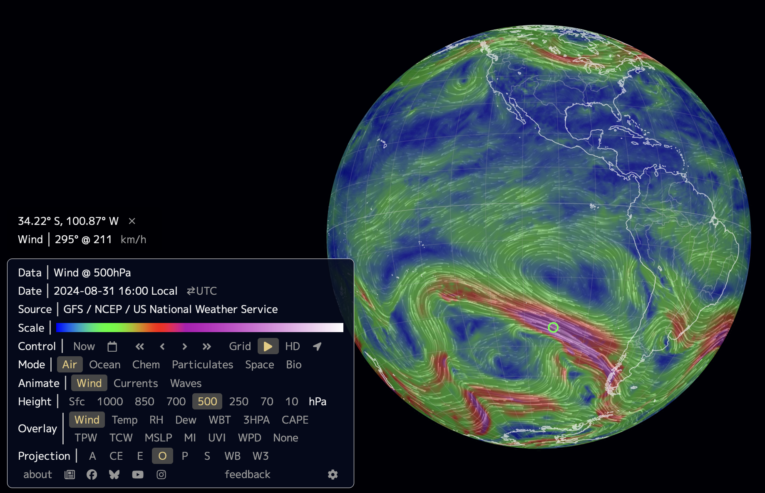
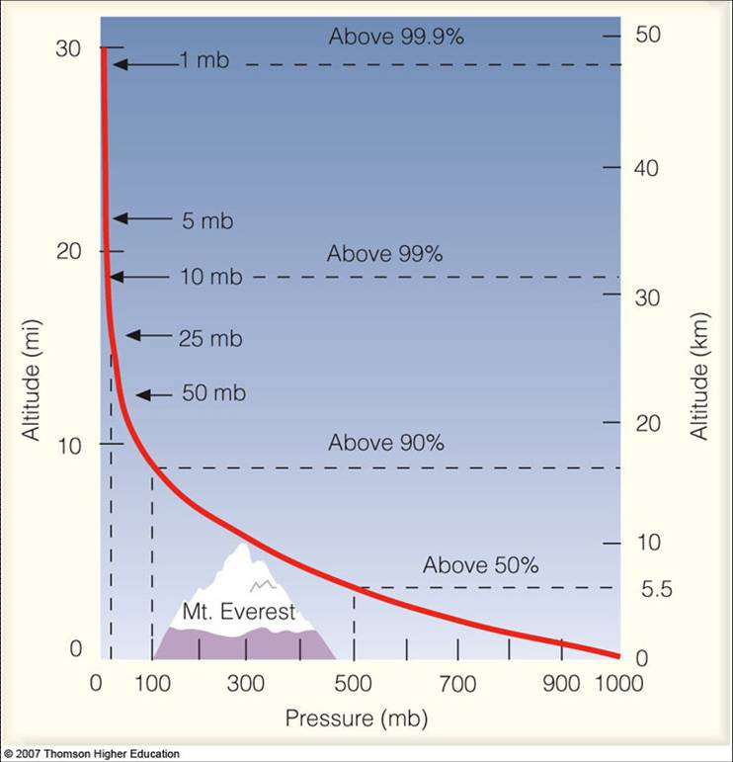

Week 2: We learned about pressure as a function of altitude, and the “Rule of 5”
Pressure in $hPa$ (AKA mbar)
The “Rule of 5”: At $5.5 km$, the pressure is $50\%$of what it is at the surface ($500 hPa=500 mbar$), and $50\%$ of Earth’s atmosphere is below you.

Slide 7
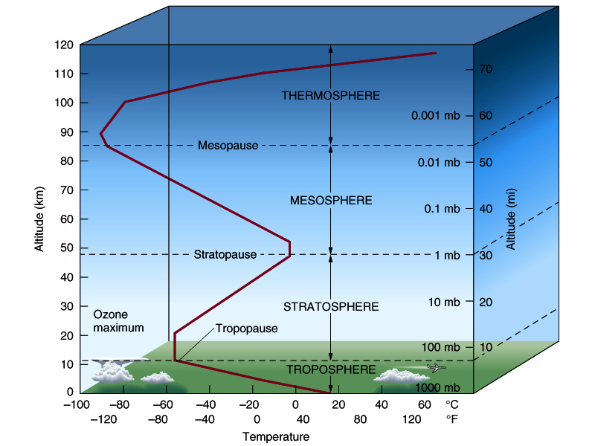
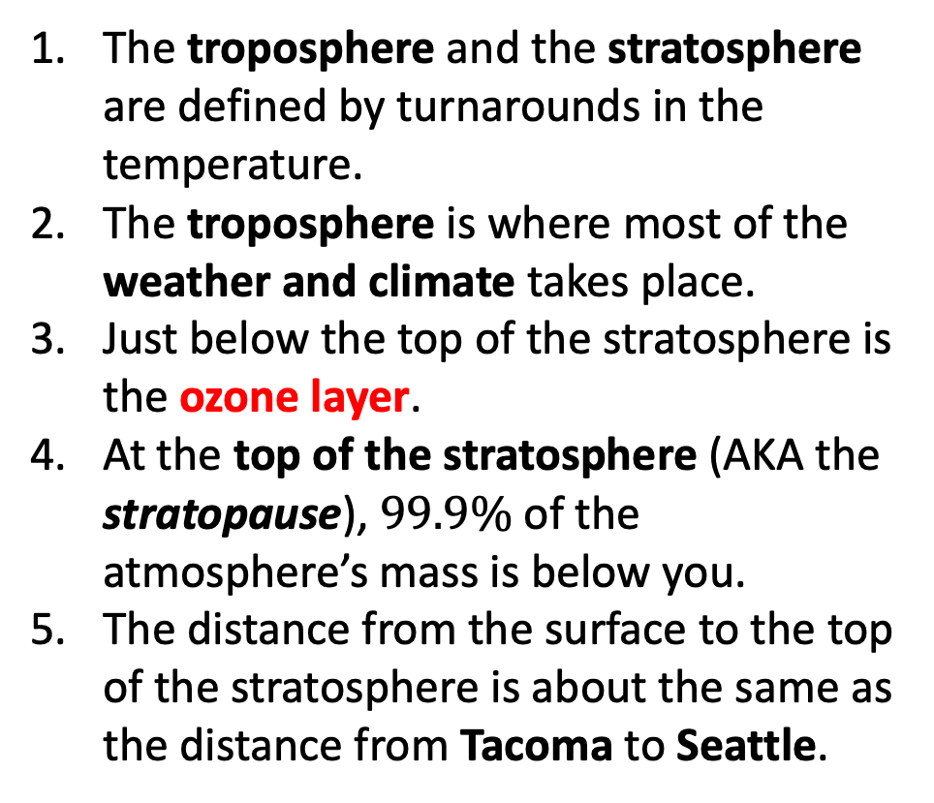
Week 2: We also learned how the troposphere and the stratosphere are defined
The troposphere and the stratosphere are defined by turnarounds in the temperature.
The troposphere is where most of the weather and climate takes place.
Just below the top of the stratosphere is the ozone layer.
At the top of the stratosphere (AKA the stratopause), $99.9\%$ of the atmosphere’s mass is below you.
The distance from the surface to the top of the stratosphere is about the same as the distance from Tacoma to Seattle.
Tacoma
Seattle

Slide 8
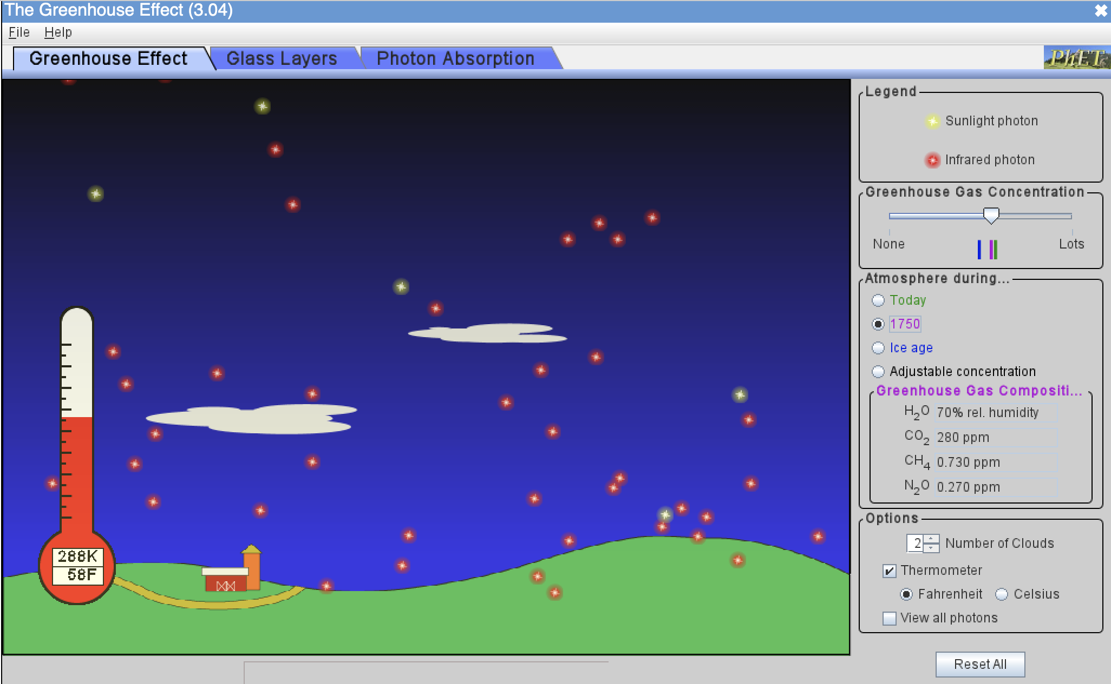
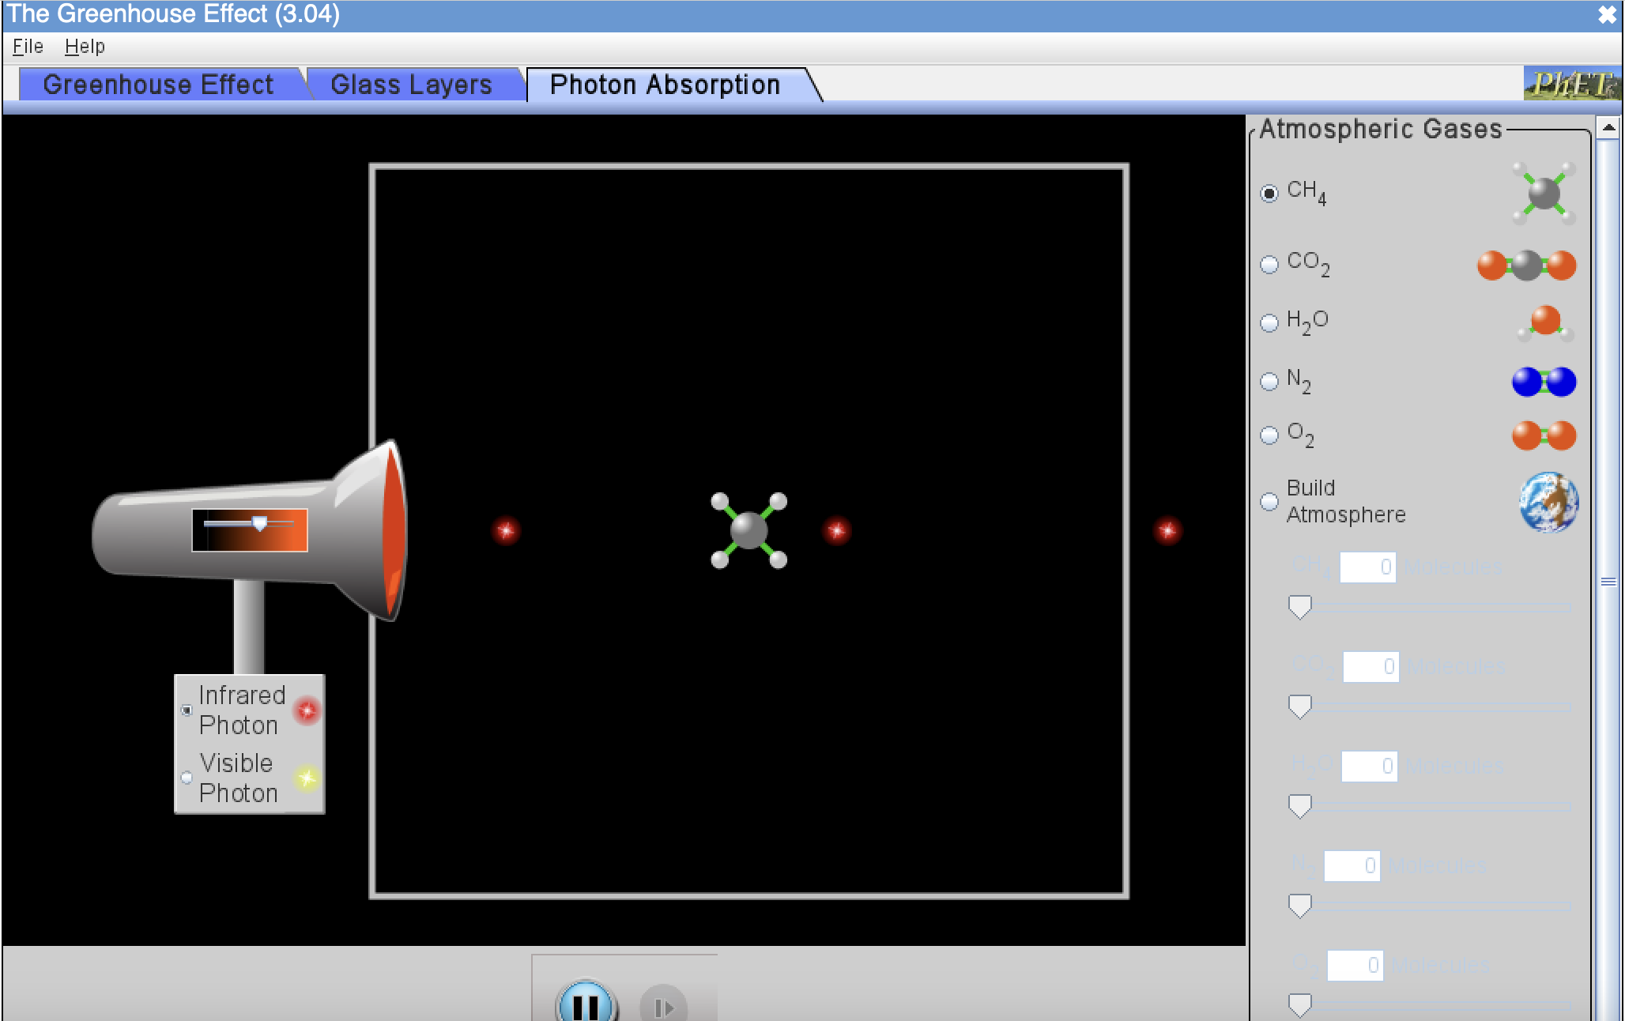
Week 2: The PhET greenhouse simulator showed us how molecules interact with LW & SW
The red photons could have been emitted by
___ the sun ___ a greenhouse gas
___ clouds ___ the earth’s surface
___ N₂ ___ O₂
The yellow photons could have been emitted by
___ the sun ___ a greenhouse gas
___ clouds ___ the earth’s surface
___ N₂ ___ O₂
Greenhouse gases
___ Can absorb SW photons
___ Can emit SW photons
___ Can absorb LW photons
___ Can emit LW photons

Slide 9
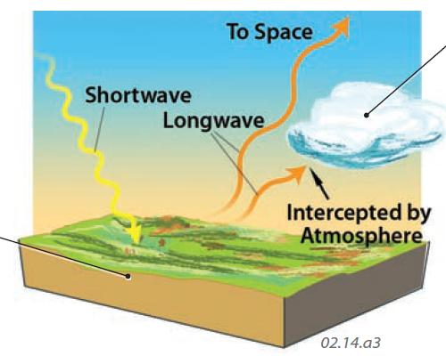
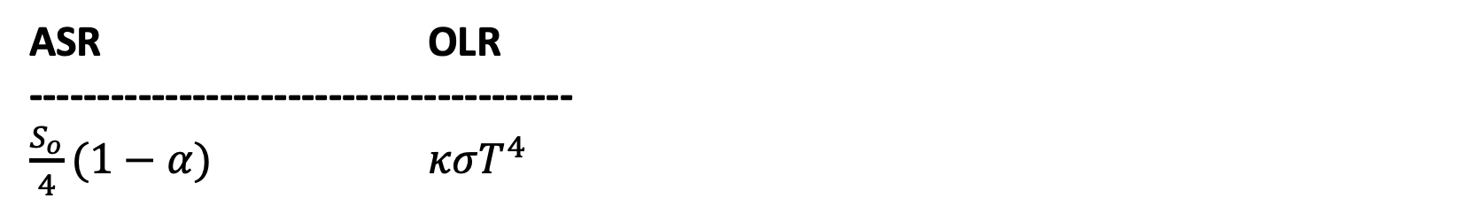
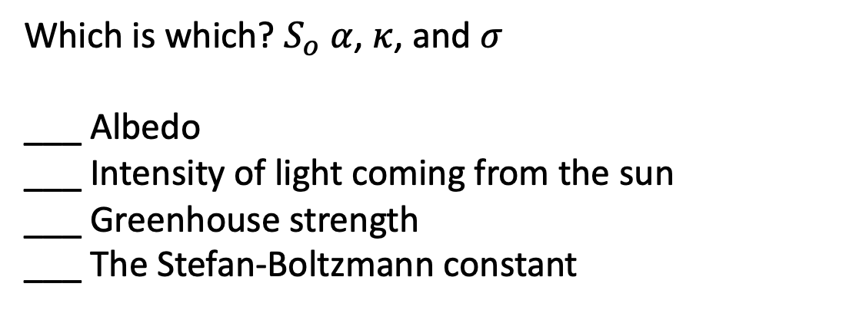
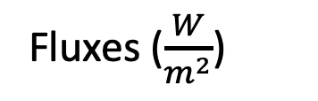
Week 2: SRB highlighted key players in Earth’s radiative balance
Fluxes ($\frac{W}{m^{2}}$)
Which is which? $S_{o}$ $α$, $κ$, and $σ$
___ Albedo
___ Intensity of light coming from the sun
___ Greenhouse strength
___ The Stefan-Boltzmann constant
ASR OLR
----------------------------------------
$\frac{S_{o}}{4}(1−α)$ $κσT^{4}$

Slide 10
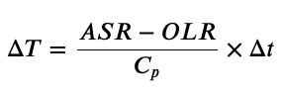
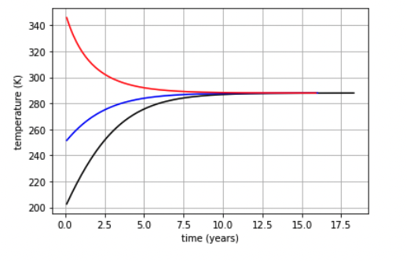
Week 2: SRB also gave us a good example of negative feedback in the climate system
The homeostatic temperature …
___ is achieved when ASR > OLR
___ is achieved when ASR < OLR
___ is achieved when ASR = OLR
___ Depends critically on the starting temperature
___ Depends on Earth’s albedo

Slide 11
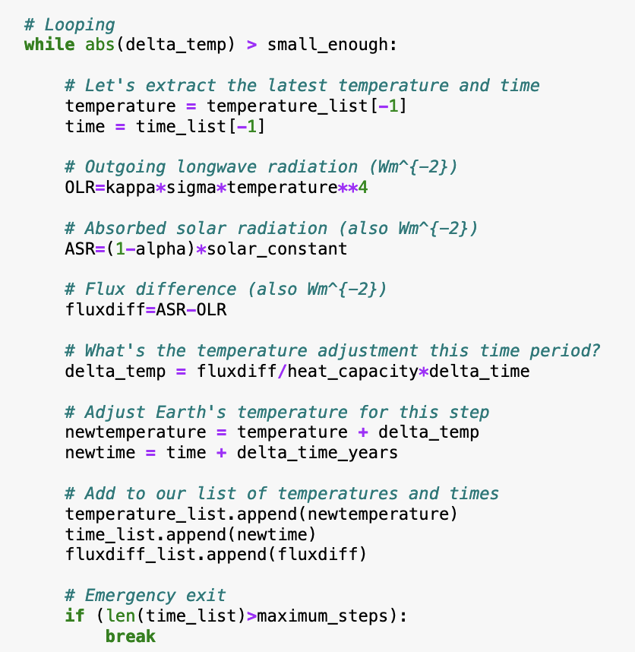
Week 2: SRB also showed us how to construct an Euler loop to predict the future
What line(s) of code may as well be taken out of this loop and put above it?
What lines of code may as well be taken out of this loop and put below it?

Slide 12
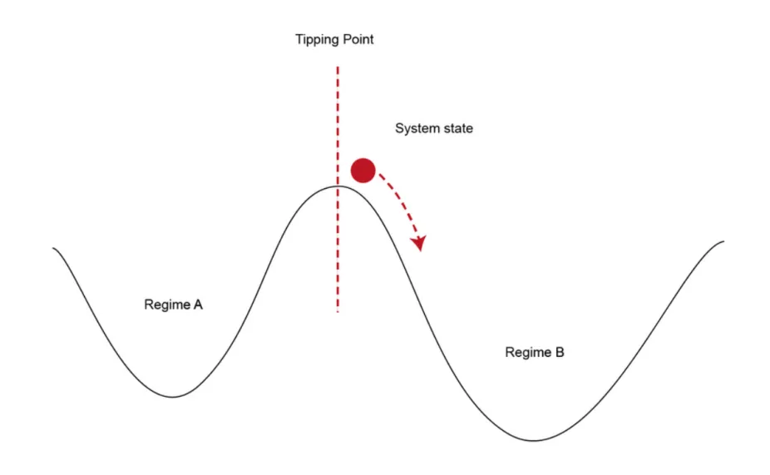
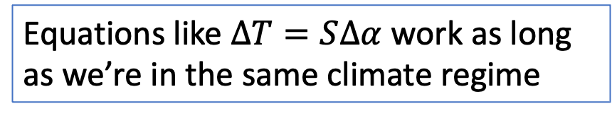
Week 3: We introduced the idea of climate forcings, and the importance of distinguishing the perturbations that keep us in one climate regime, vs those that tip us over into the other
As we get close to a new climate regime, even tiny forcings can send us over into it. Very difficult to predict where we’ll end up.
Small perturbations might change climate a little, but the results are still predictable
forcing
Equations like $∆T=S∆α$ work as long as we’re in the same climate regime
https://scied.ucar.edu/sites/default/files/styles/extra_large/public/images/tippingpoint_CC_rauter.png.webp?itok=jjVx9OvH

Slide 13
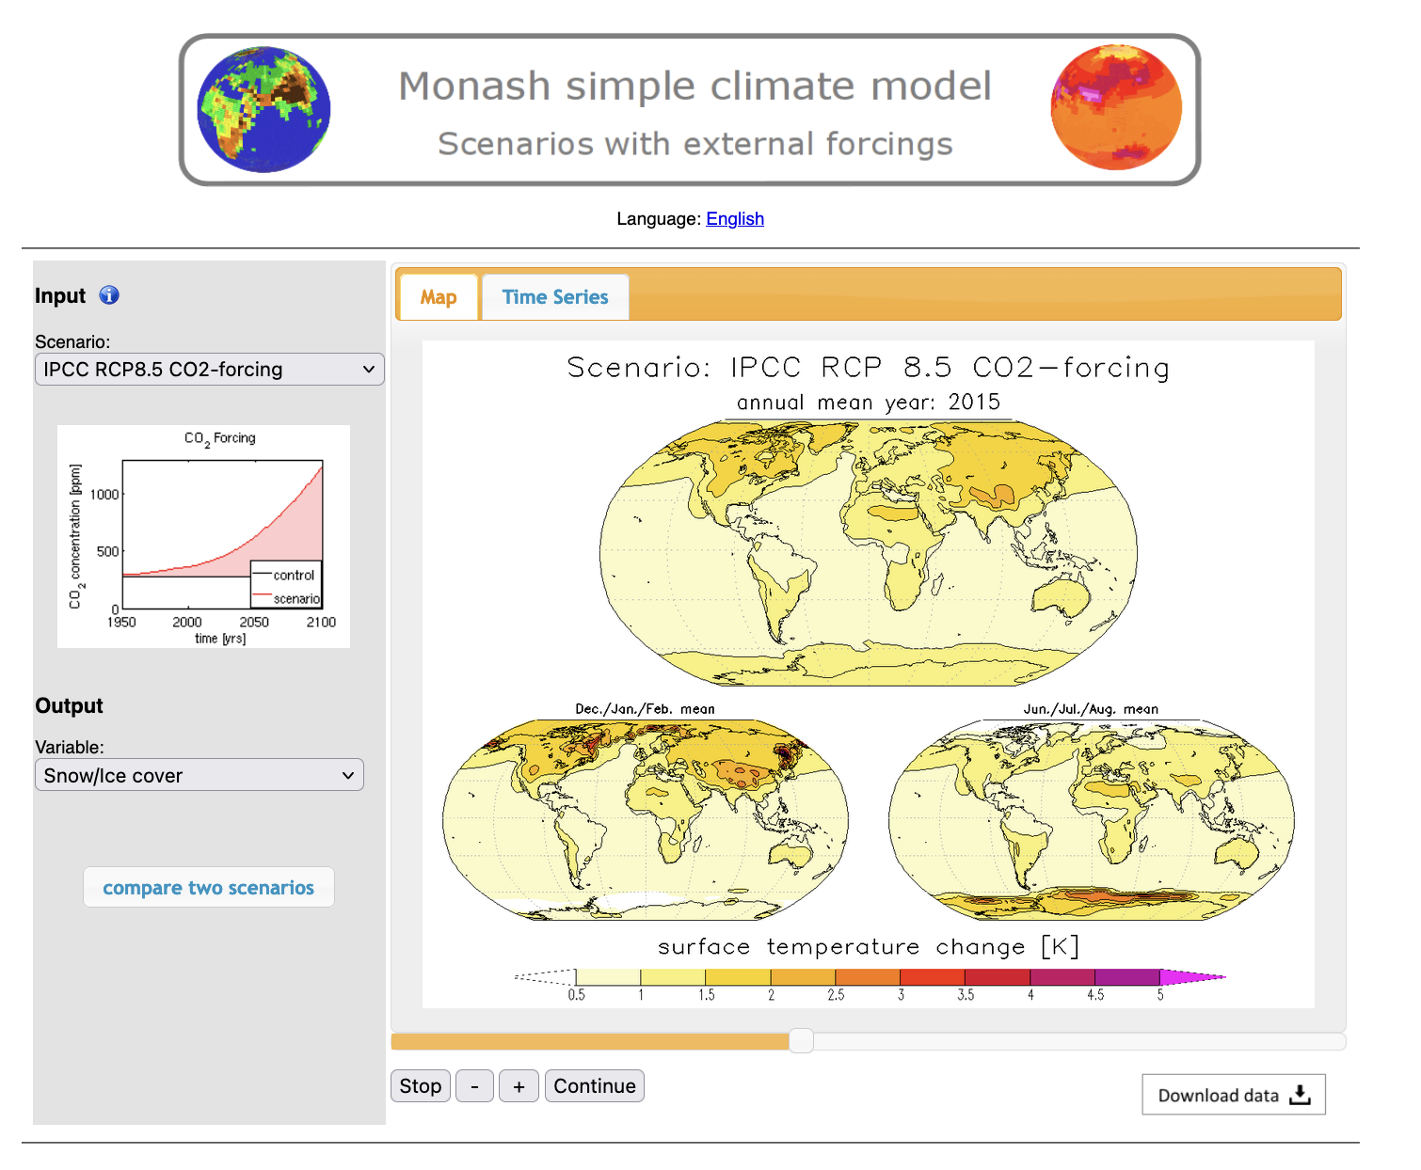
Week 3: Monash gave us geographic & temporal details about possible climate-altered futures
What kinds of temperature increases might we be looking at?
What kind of impacts on snow/ice cover?
What parts of the world are warming faster than others?
Is the Equilibrium Climate Sensitivity built into these models reasonable?

Slide 14
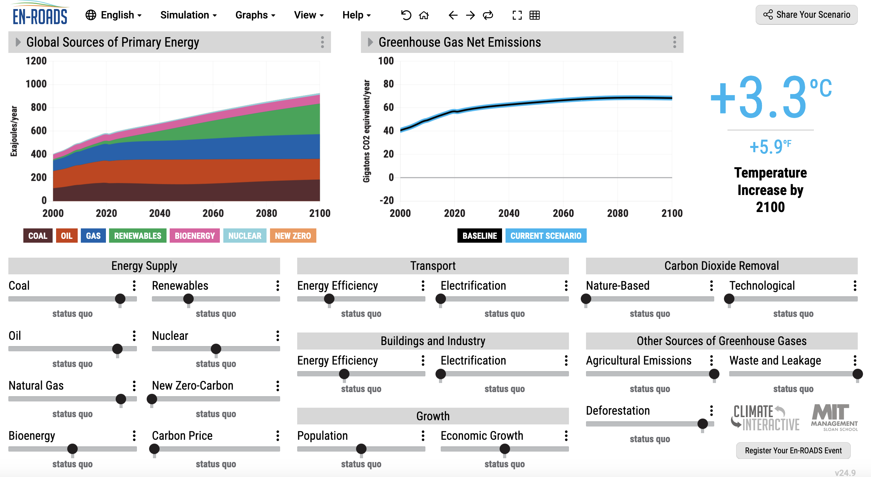
Week 3: EnROADs showed us possible routes to staying below 2 degrees warming

Slide 15
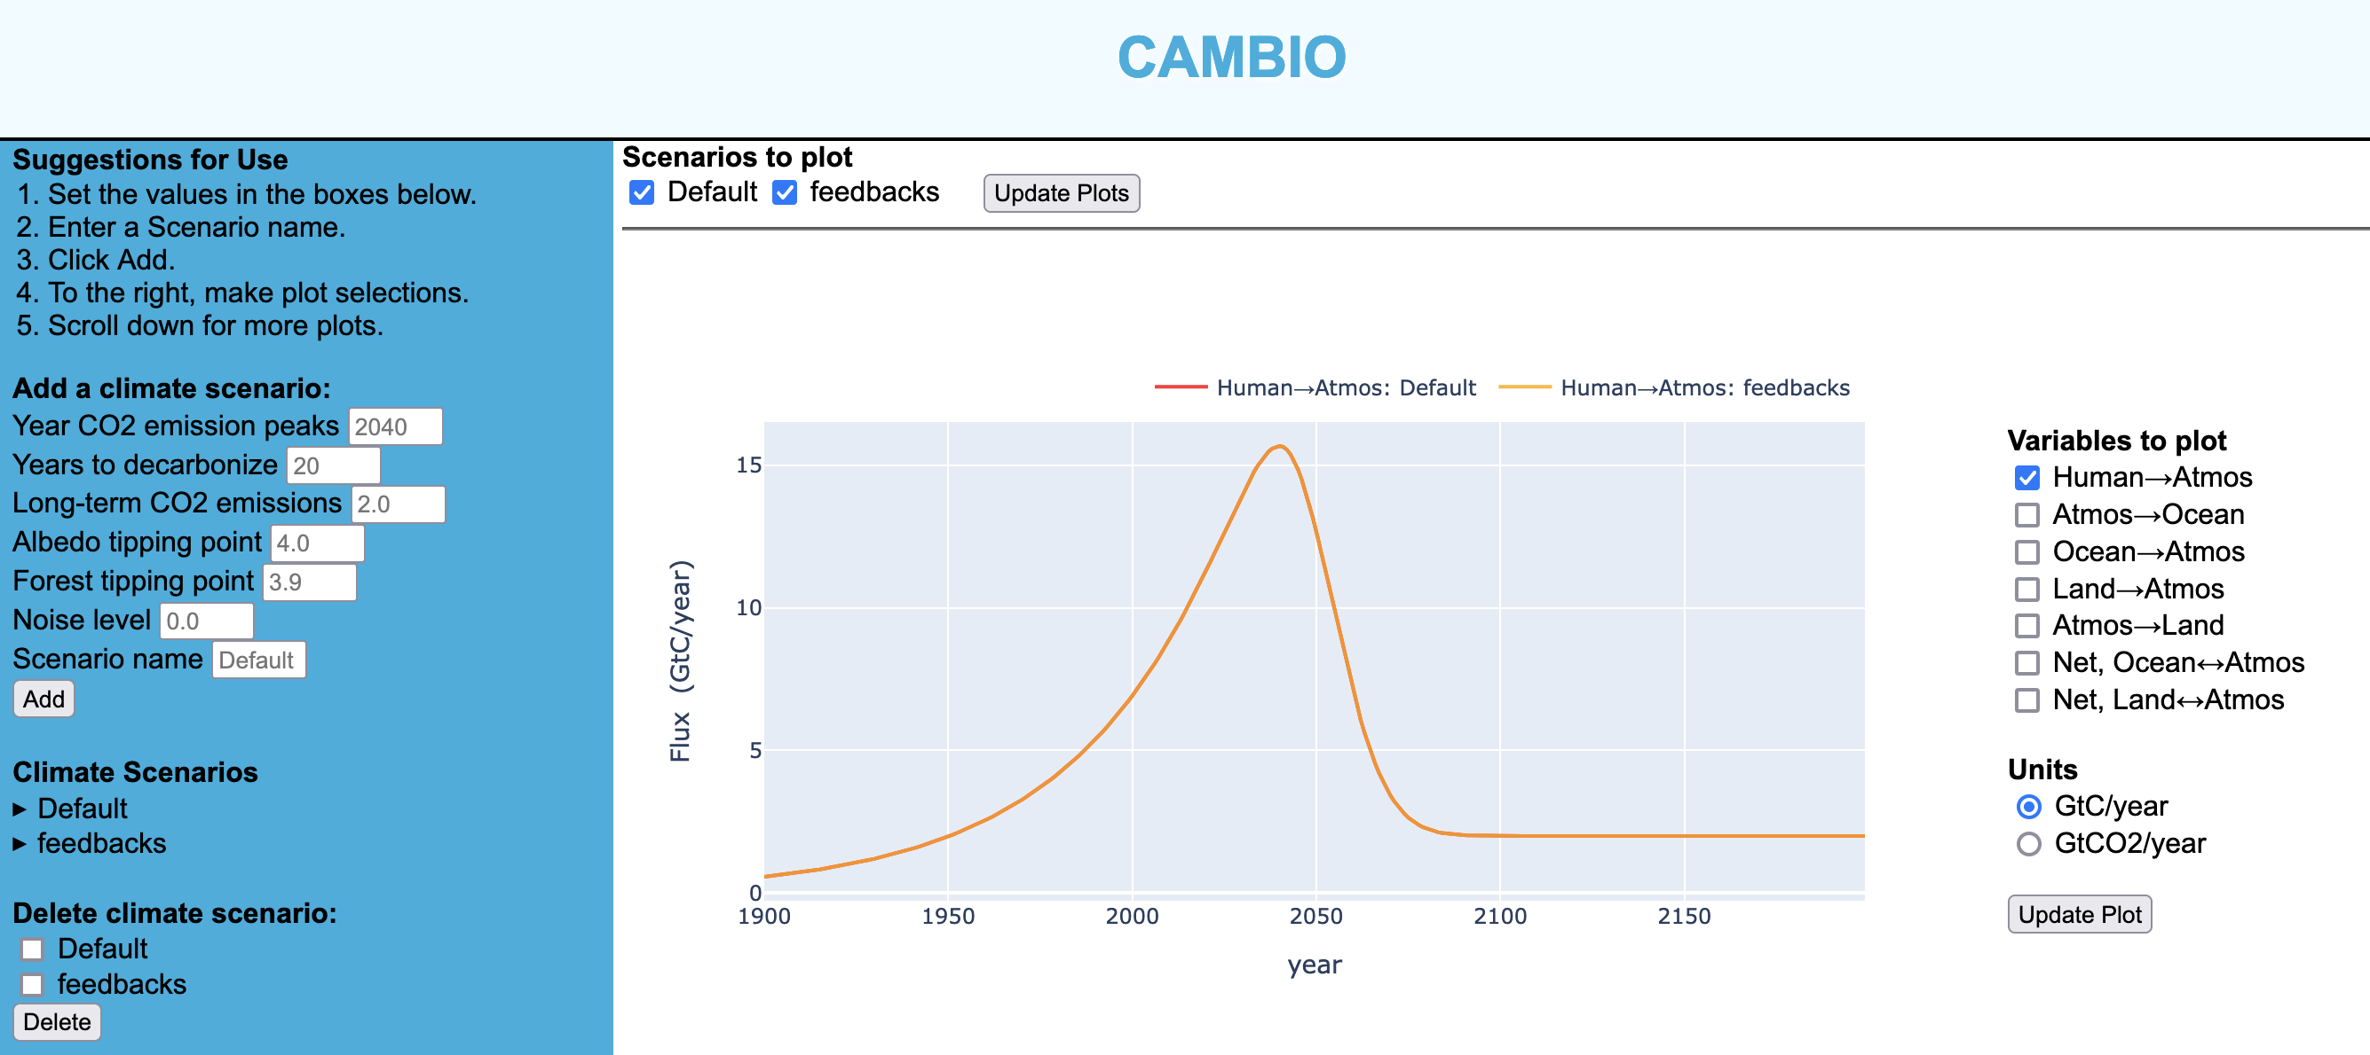
Week 3: Cambio showed us what can happen if we get too close to tipping points

Slide 16
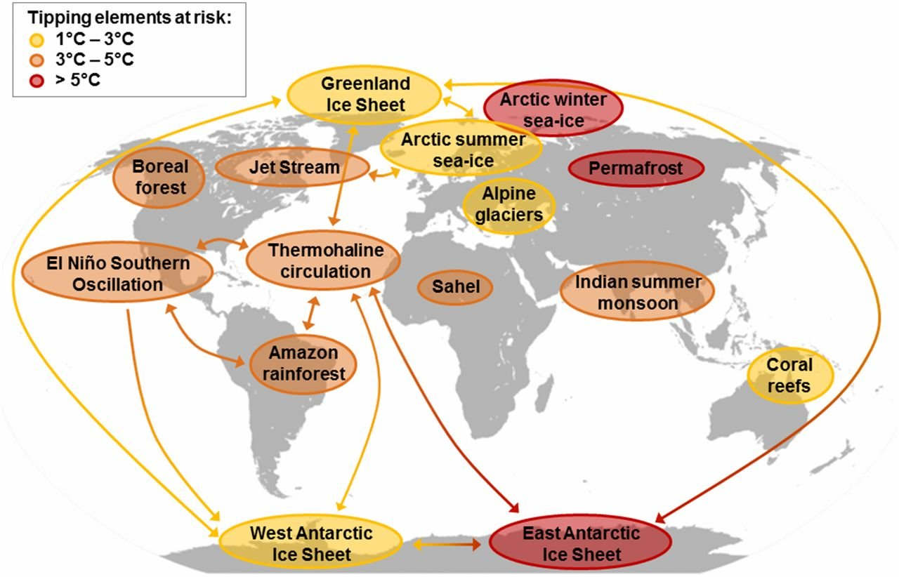
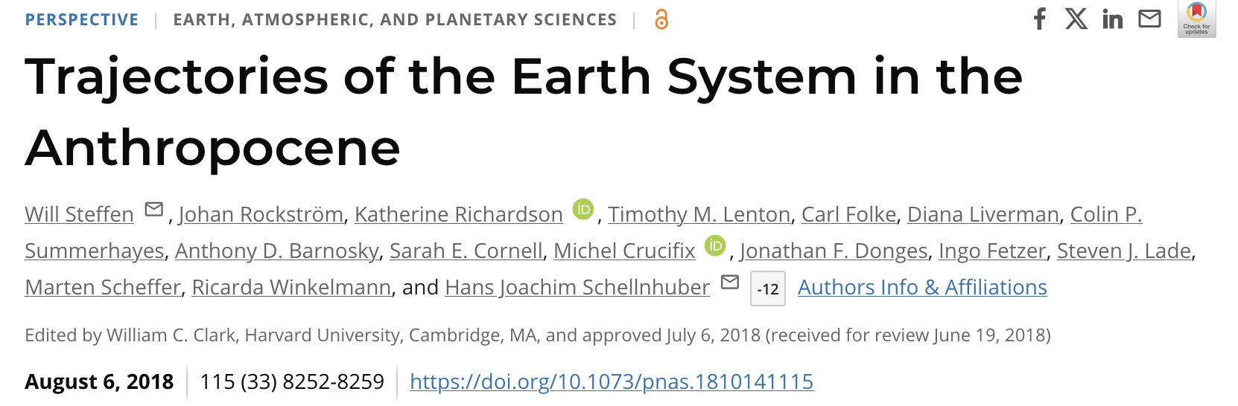
Week 4: We learned about the difference between tipping points and tipping elements

Slide 17
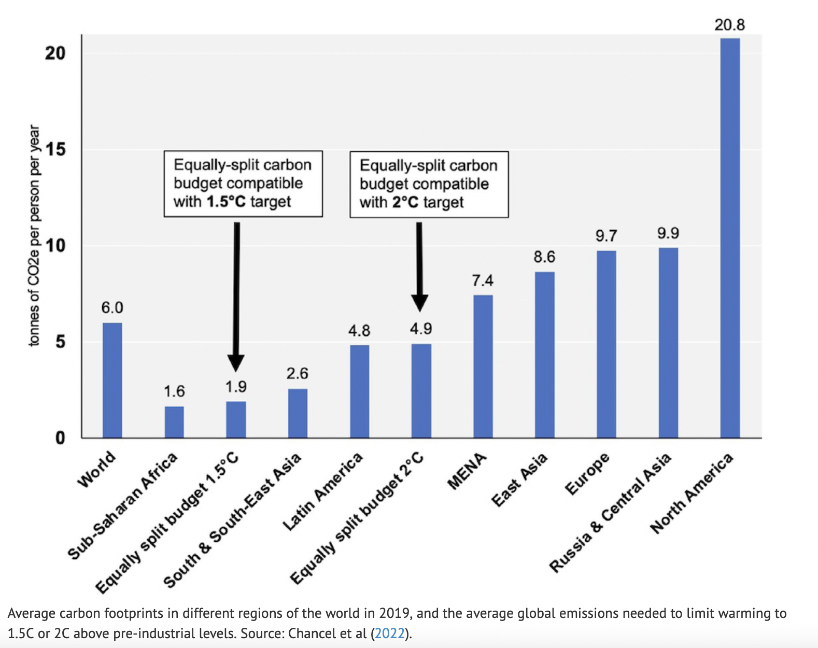
Week 4: We got a sense of per-capita budgets needed to avoid 2 degrees warming

Slide 18
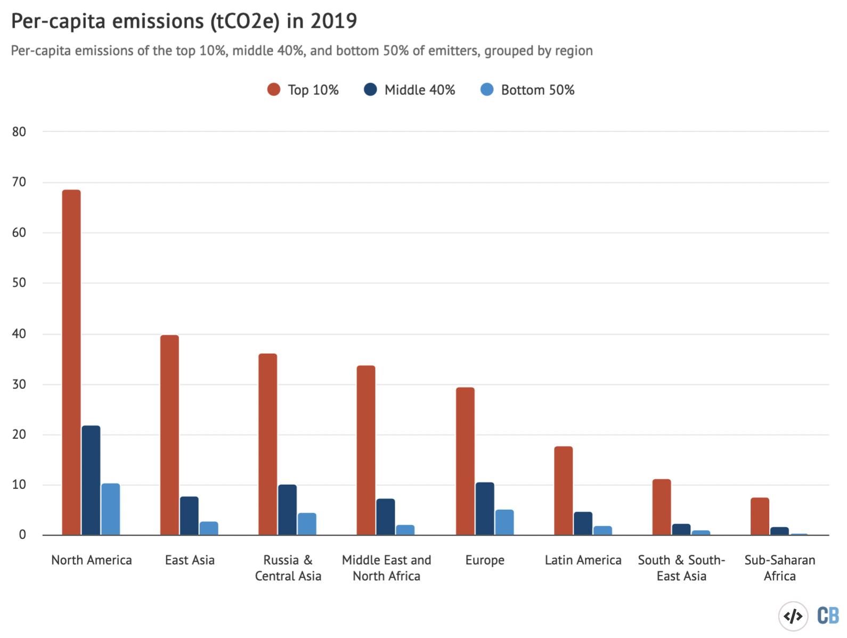
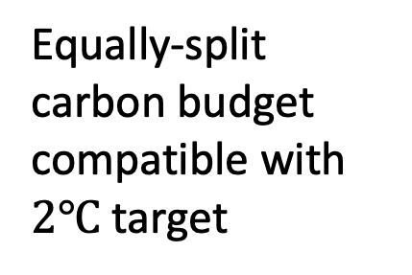
Week 4: We saw that there’s a lot of within-country variability of emitters
Equally-split carbon budget compatible with $2℃$ target

Slide 19
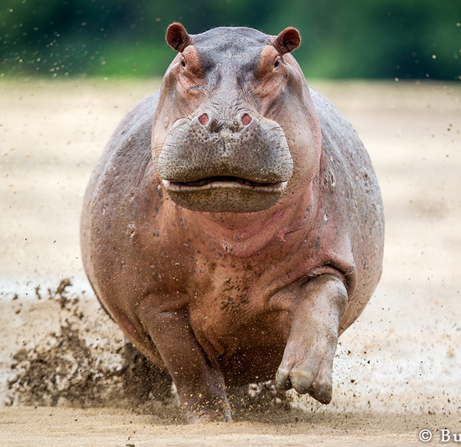
Week 4: We compared personal climate mitigation agency vs collective climate mitigation agency
Laws & incentives (whatever gov’ts can do)
Don’t eat beef
Cars (1/5)
Flying (1/5)

Slide 20
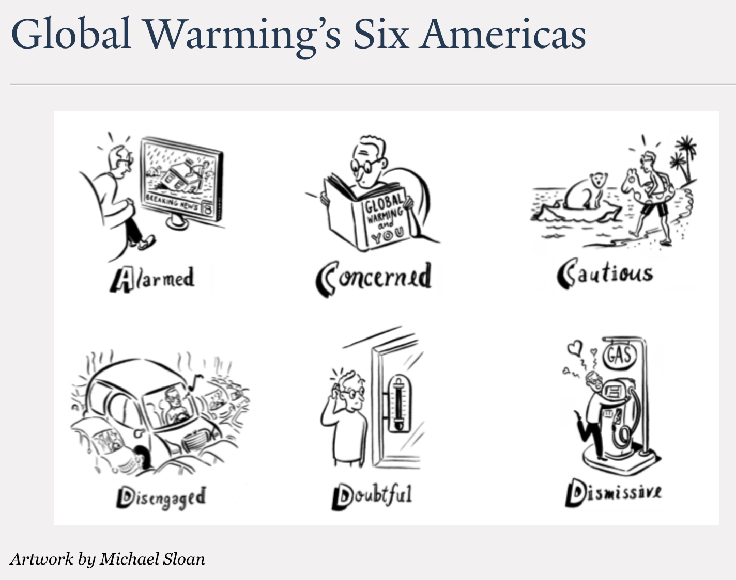
Week 4: We applied rhetorical devices that could improve conversations about climate change
Schrempfer: Ask three questions:
How does it function? (Or: What is its goal?)
Who does it benefit?
Where is the power?
Rowe: Explore an idea by replacing one word or concept with another, to see how it sits.

Slide 21
Week 4: Learned about broad divisions in human responses to the climate crisis
Climate change mitigation means avoiding and reducing emissions of heat-trapping greenhouse gases into the atmosphere to prevent the planet from warming to more extreme temperatures. We can further subdivide this into
Supply-side mitigation (carbon-free energy sources, for example)
Demand-side mitigation (public transportation, for example)
Climate change adaptation means altering our behavior, systems, and—in some cases—ways of life to protect our families, our economies, and the environment in which we live from the impacts of climate change.

Slide 22
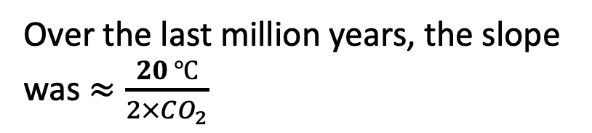
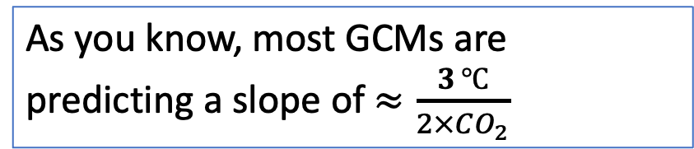
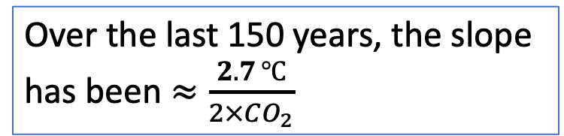
Week 5: We compared GCM-derived ECS to the ECS of the last 150 years, and the Pleistocene
Over the last million years, the slope was $≈\frac{20 ℃}{2×CO_{2}}$
As you know, most GCMs are predicting a slope of $≈\frac{3 ℃}{2×CO_{2}}$
T (relative to 1960)
Over the last 150 years, the slope has been $≈\frac{2.7 ℃}{2×CO_{2}}$
Courtesy Penny Rowe
Courtesy Penny Rowe

Slide 23
Week 5: We returned to the idea that climate forcings that leave us in something like the current climate (Pleistocene/Holocene/Icehouse Earth), are pretty different from forcing that tips us into a new climate that looks (more like Hothouse Earth)
For the last 3 million years, Earth’s climate has been Pleistocene-like (“Icehouse Earth”)
But as we get close to a new climate regime, even tiny forcings can send us over into much hotter climate (“Hothouse Earth”)
forcing
https://scied.ucar.edu/sites/default/files/styles/extra_large/public/images/tippingpoint_CC_rauter.png.webp?itok=jjVx9OvH

Slide 24
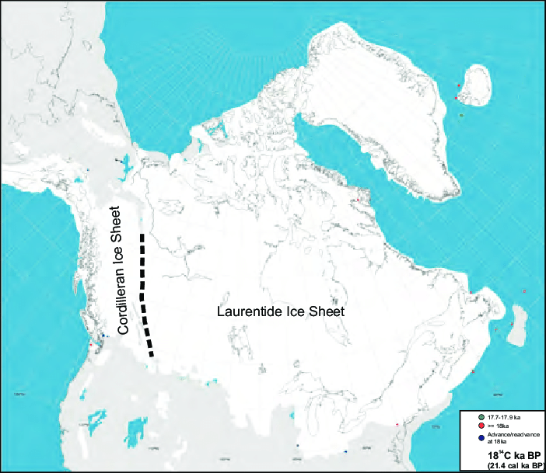
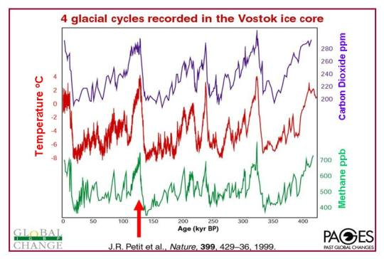
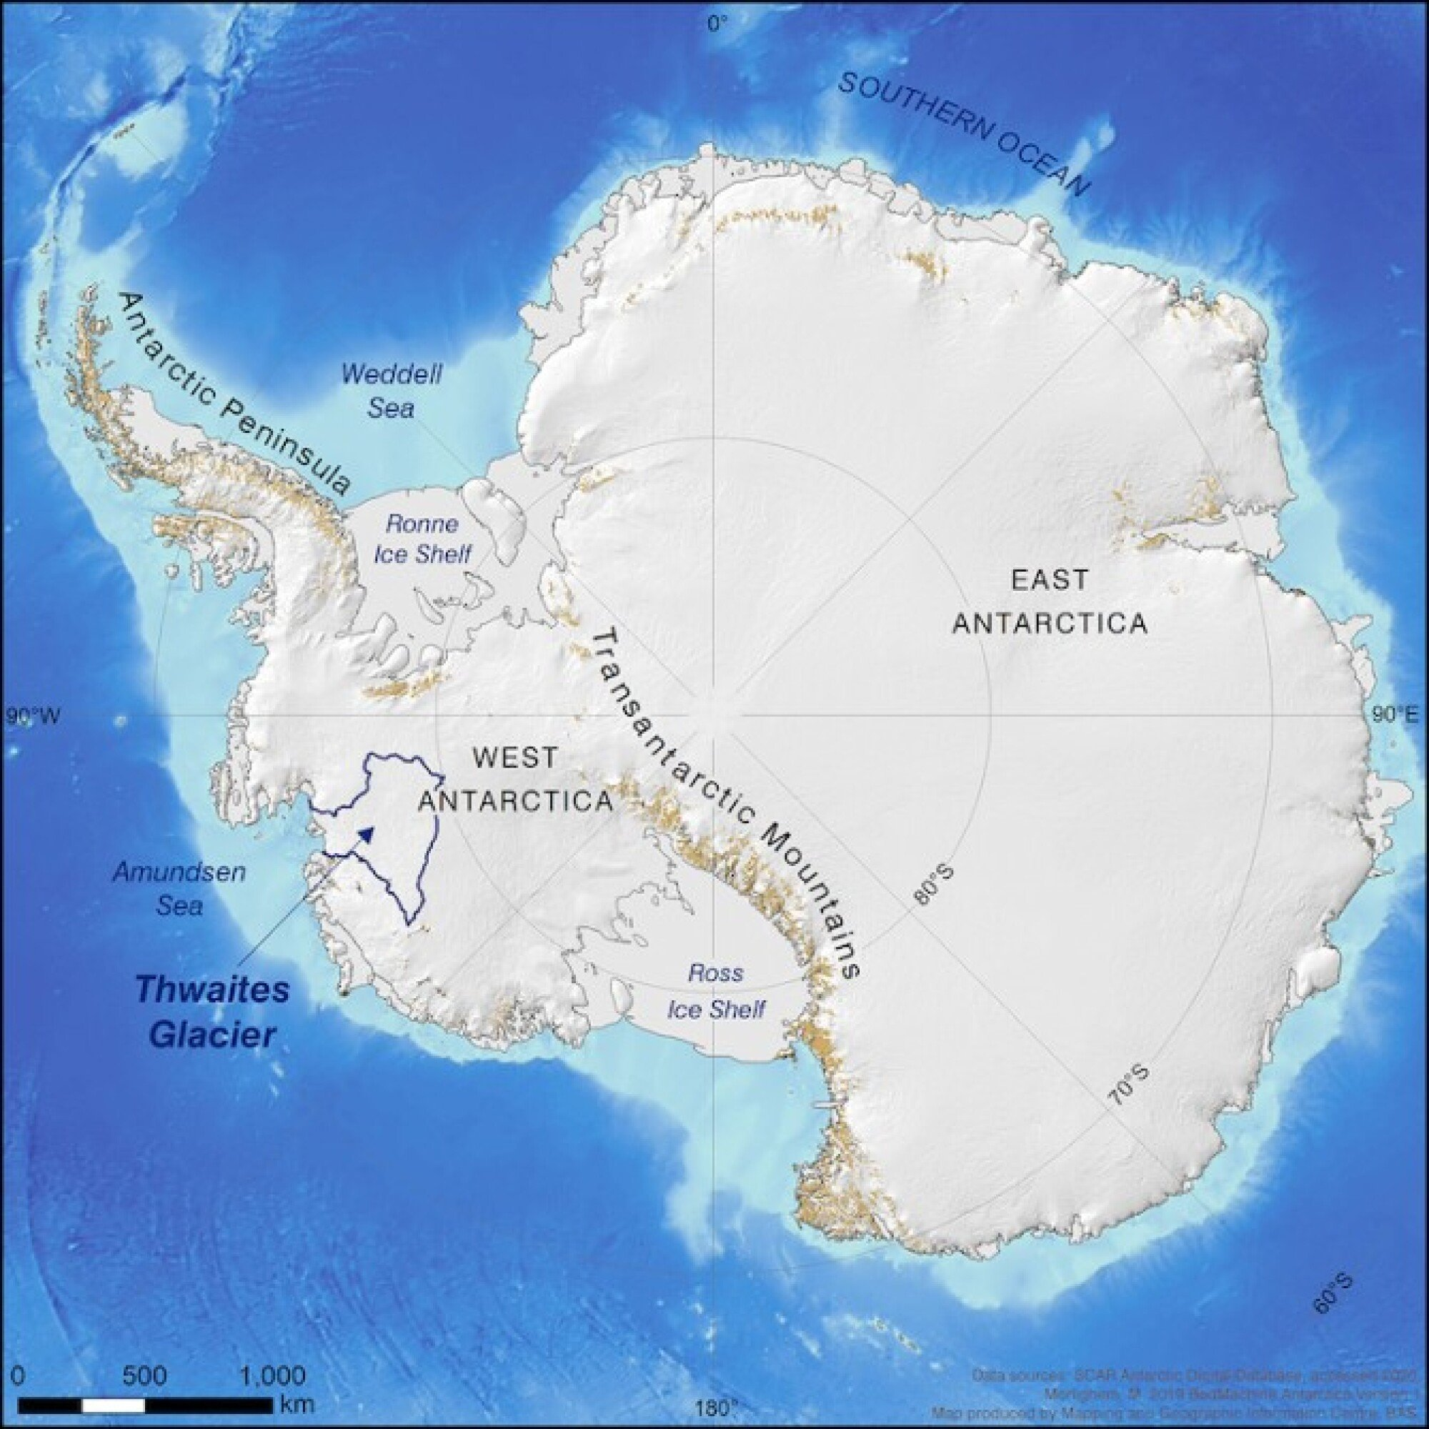
Week 5: We considered the climate variability of the Pleistocene (90,000 years of cold)
Present <------- 400,000 years ago

Slide 25
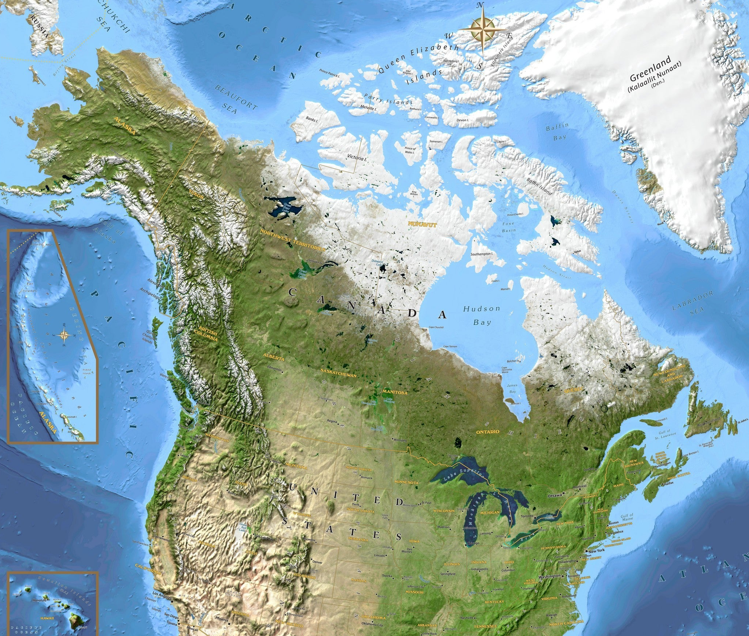
Week 5: We considered the climate variability of the Pleistocene (10,000 years of warm)
Present <------- 400,000 years ago
N. American (and Asian) ice sheets recede
Eemian
WAIS slipped into the ocean during the Eemian (but hasn’t done so in our current warm period)

Slide 26
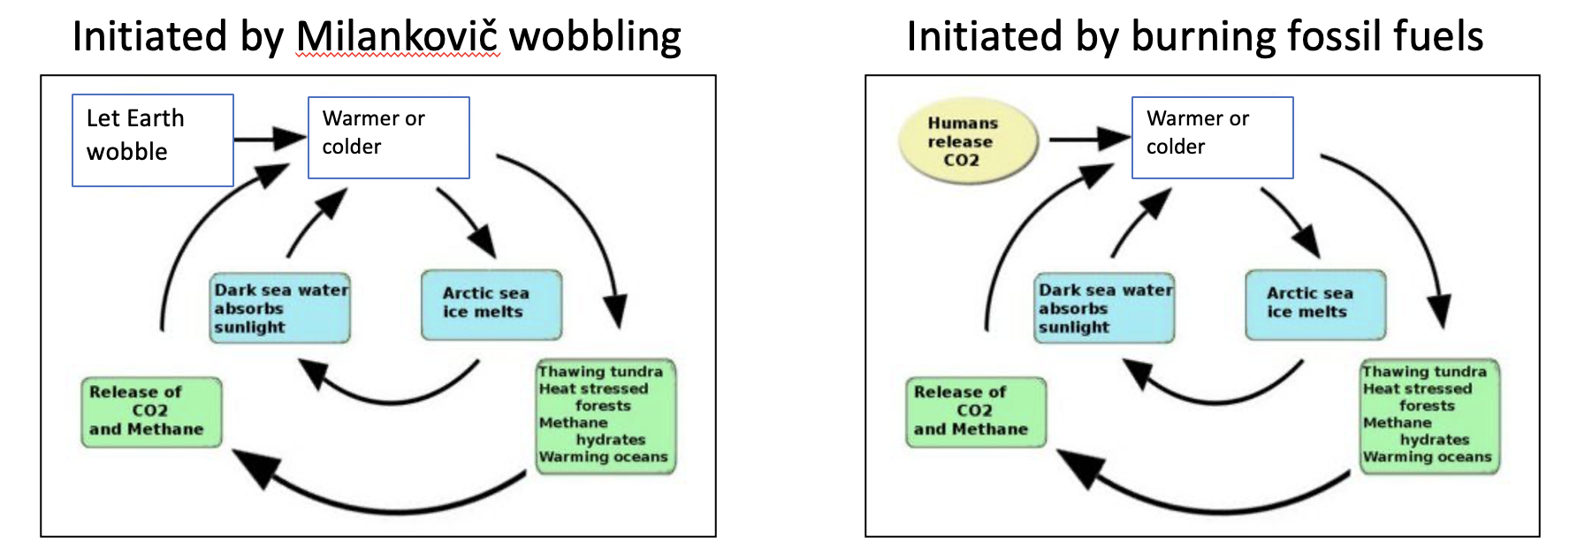
Week 5: We talked about the “Pleistocene experiment”

Slide 27
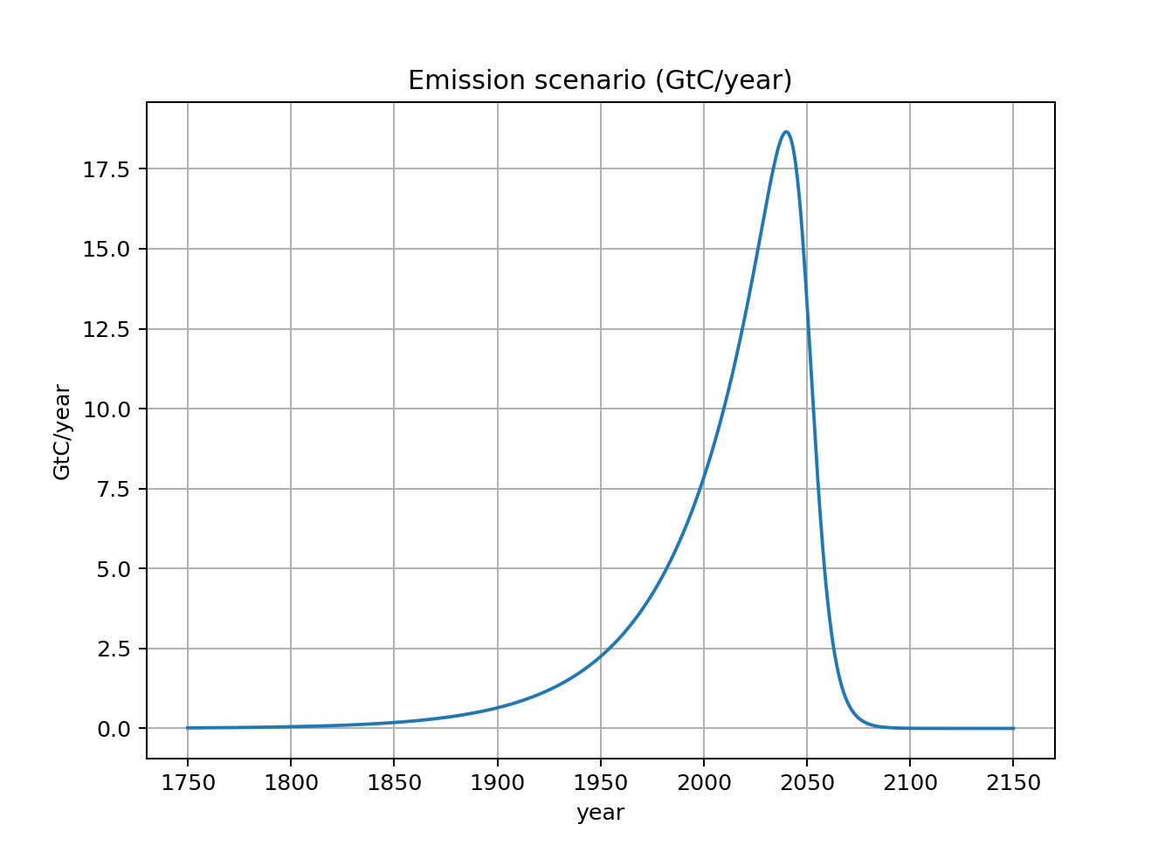
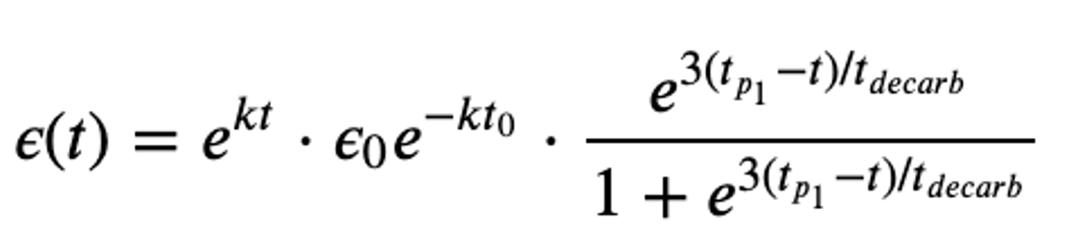
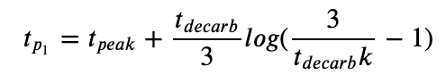
Week 5: Wrote code that creates an “emission scenario” (ScheduledFlows)

Slide 28
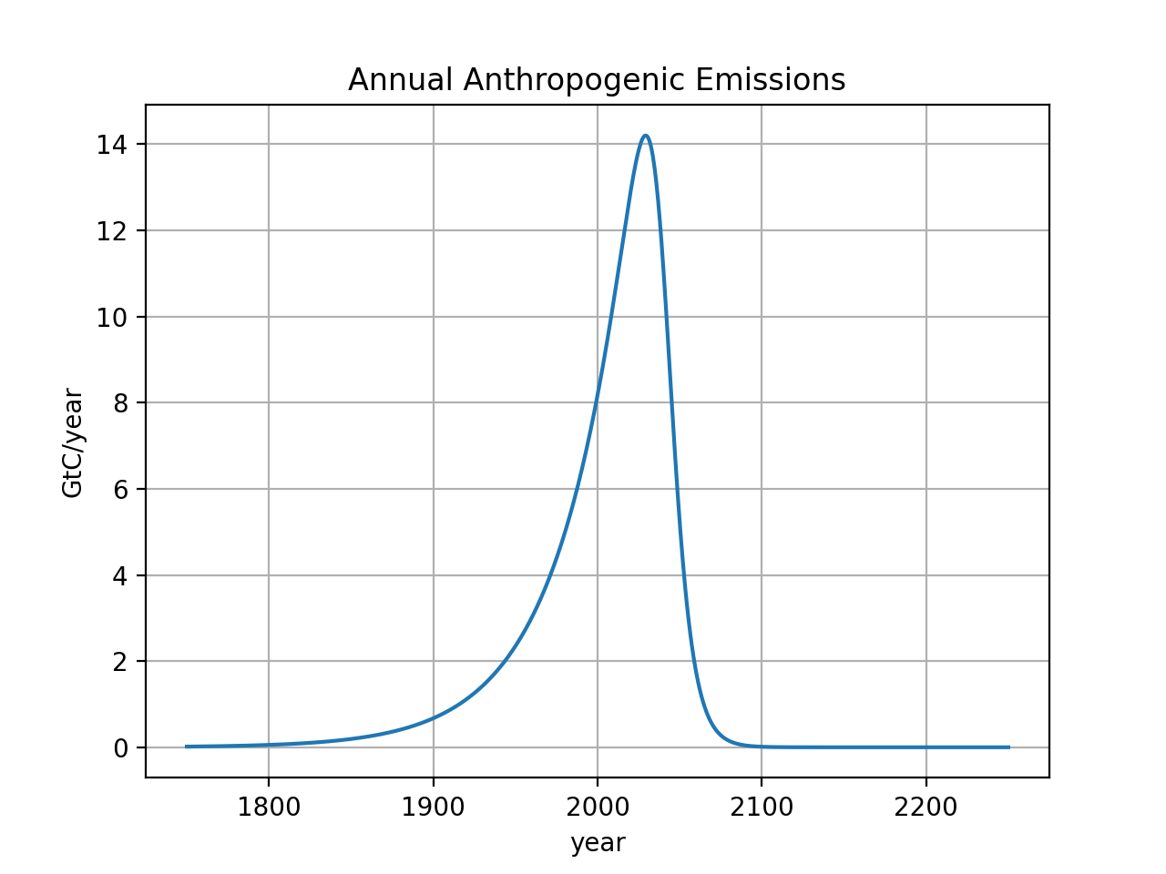
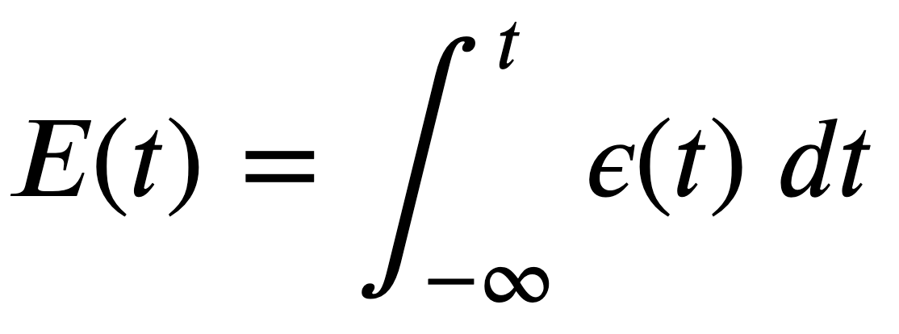
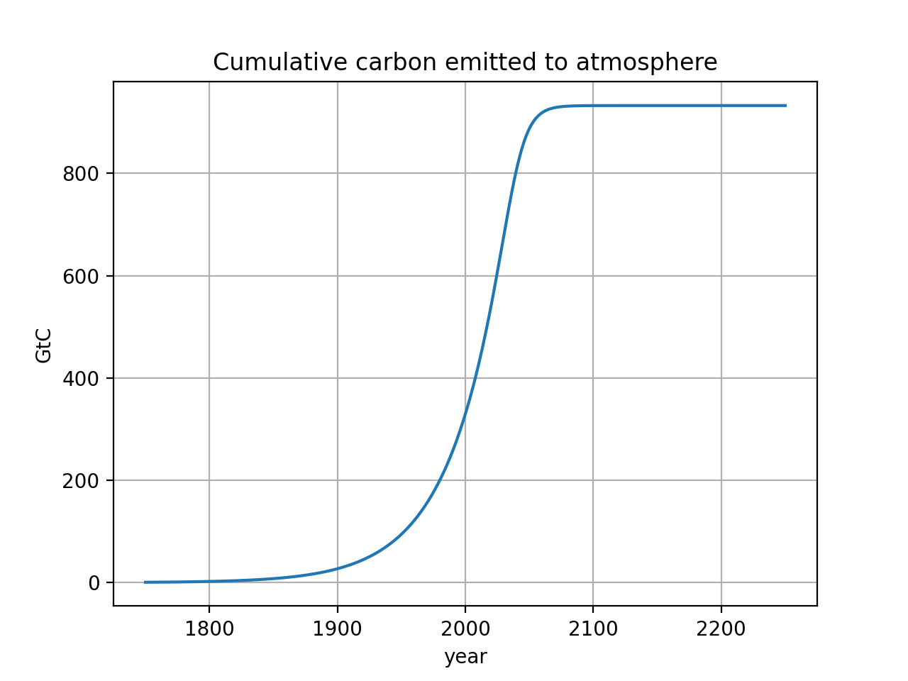
Week 5: Wrote code that sets up an Euler loop (CumulativeAnalysis)
Integral calculus:
$\sim 1000$ GtC burned in this scenario
It’s thought that ~4000 GtC is the total Earth reserve, so ~70-75% would be left in the ground
In Python:
Notes:
http://www.igbp.net/news/features/features/havewereachedpeakco2.5.1b8ae20512db692f2a680003465.html

Slide 29
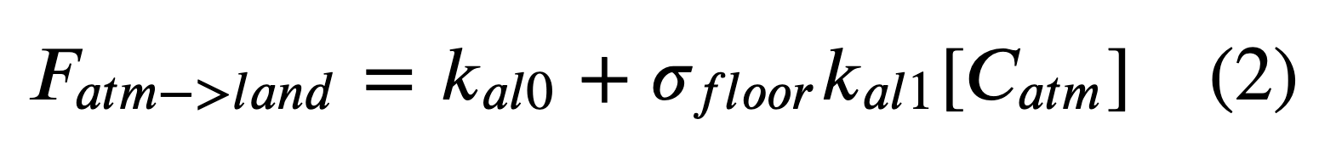
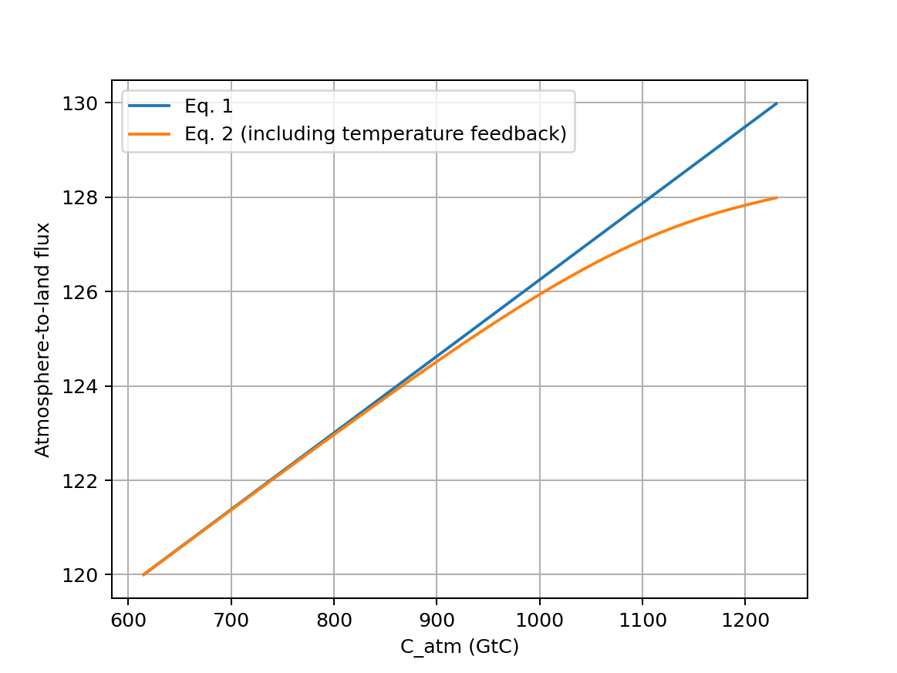
Week 5: We looked at algorithms representing $CO_{2}$ fertilization and temperature feedback (AdaptiveFlows)

